Slide 1



A Industrial Project On
Image Sharpening Using Knowledge Distillation
UNDER THE GUIDENCE OF
DR.GAJENDRAN MALSHETTY
(Chairperson, Dept of Artificial Intelligence and Data Science, Sharnbasva University Kalaburagi 585103)
SUBITTED BY
Chetan Garoor(Team Lead)
Arunkumar Kankeri
Sanket G
Revansidappa T

Slide 2
INTRODUCTION
One of the common issues affecting image quality is blurring, which can occur due to camera motion, object movement, defocusing, or low lighting conditions.
Image sharpening--the process of enhancing image clarity by recovering lost details—has become a significant area of research in the field of computer vision and image processing.
With the rise of deep learning, Convolutional Neural Networks (CNNs) have proven highly effective in learning complex mappings between degraded and high-quality images, making them suitable for tasks like image denoising, deblurring, and super-resolution.
Despite their effectiveness, deep CNNs are often computationally intensive, involving millions of parameters and requiring powerful GPUs for training and inference.
This makes them unsuitable for deployment on resource-constrained devices such as smartphones, embedded systems, or IoT devices. To address this limitation, the concept of Knowledge Distillation (KD) has emerged as a powerful solution. Knowledge distillation involves training a smaller, lightweight “student” model to learn from a larger, more accurate “teacher” model. The student network can then mimic the performance of the teacher while being significantly faster and more efficient.

Slide 3
PROBLEM STATEMENT
Blurry images caused by motion, defocus, or low-resolution inputs degrade the quality of visual content, especially in real-time applications like video conferencing and surveillance. Traditional sharpening techniques often fail to recover fine details or introduce artifacts. While deep learning models achieve high-quality restoration, they are too large for deployment on edge devices. This project aims to solve this challenge by using knowledge distillation to train a lightweight student model that mimics a high-performing teacher model, delivering sharp, high-quality images in real time with reduced computational cost.

Slide 4
OBJECTIVES
Develop a high-performance teacher model for image sharpening using deep convolutional neural networks trained on paired blurry and sharp image datasets.
Design a lightweight student model capable of mimicking the teacher’s output quality with significantly fewer parameters and faster inference time.
Implement knowledge distillation by combining reconstruction loss, perceptual loss (VGG-based), and distillation loss to guide the student model’s learning.
Create a synthetic dataset of blurred and sharp image pairs using standard datasets (e.g., CIFAR-10) with controlled Gaussian blur to simulate real-world degradation.
Evaluate model performance using Structural Similarity Index (SSIM) to ensure perceptual and quantitative image quality.
Build a user-friendly web interface using Flask that allows users to upload blurry images and view sharpened results in real time.
Ensure deployability of the student model on edge devices by maintaining low latency and high output fidelity.

Slide 5
FLOWCHART
FLASK WEB APPLICATION
BLURRY IMAGE
TEACHER MODEL
KNOWLEDGE DISTILLATION
STUDENT MODEL
IMAGE SHARPENING

Slide 6
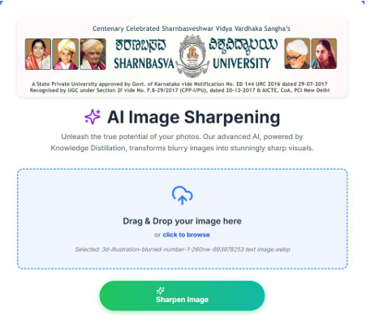
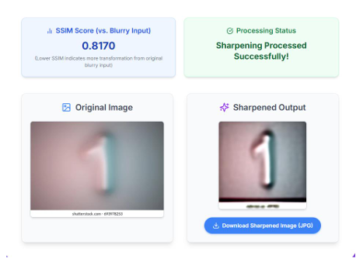
RESULT

